Slide 1
Service bulletin H-D Pro bearing Leeboy # 870030-HD
Leeboy has updated the housing on 870030 to steel.
This is in the HD pro screed application only.
8/15/2024

Slide 2
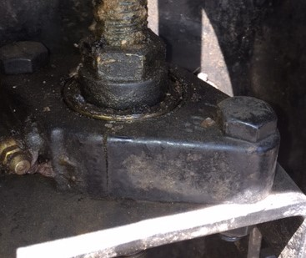
The HD pro screed is found on the
8520C, 8608, 8530 and 8616D.
This bearing has cracked in some cases,
causing the screed to not hold position
while paving. Resulting in mat issues.

Slide 3
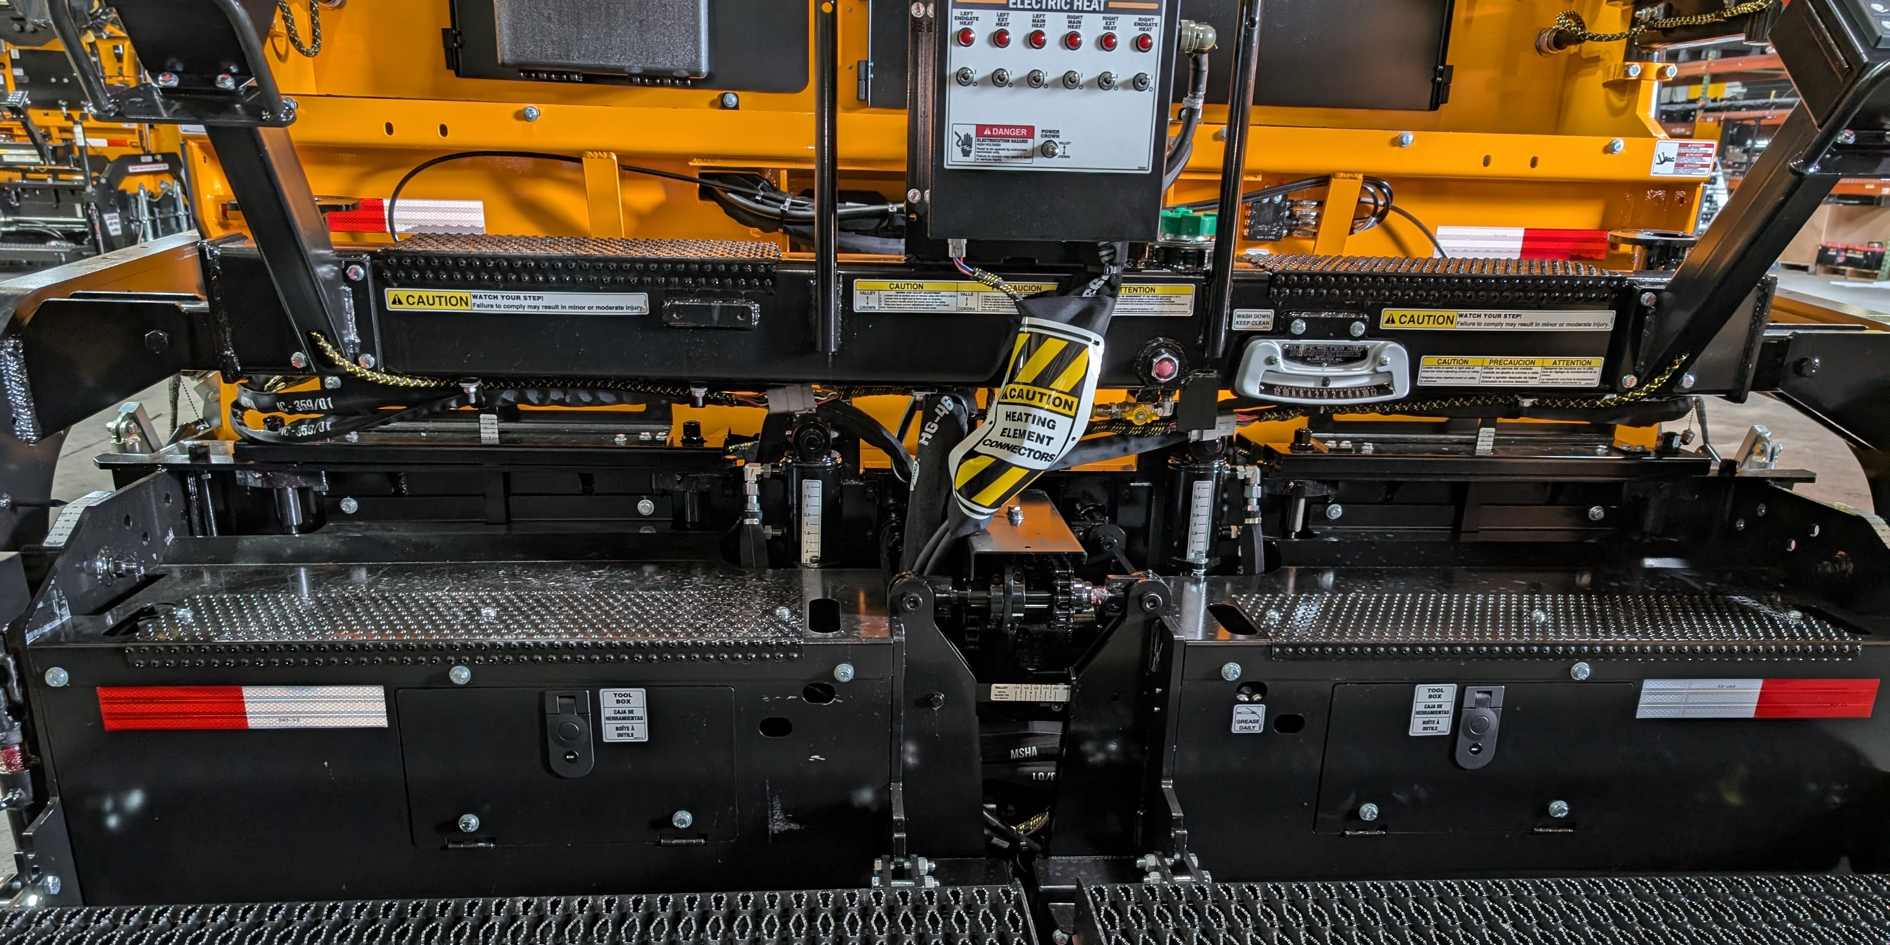
These are located as part of the box height adjustment

Slide 4
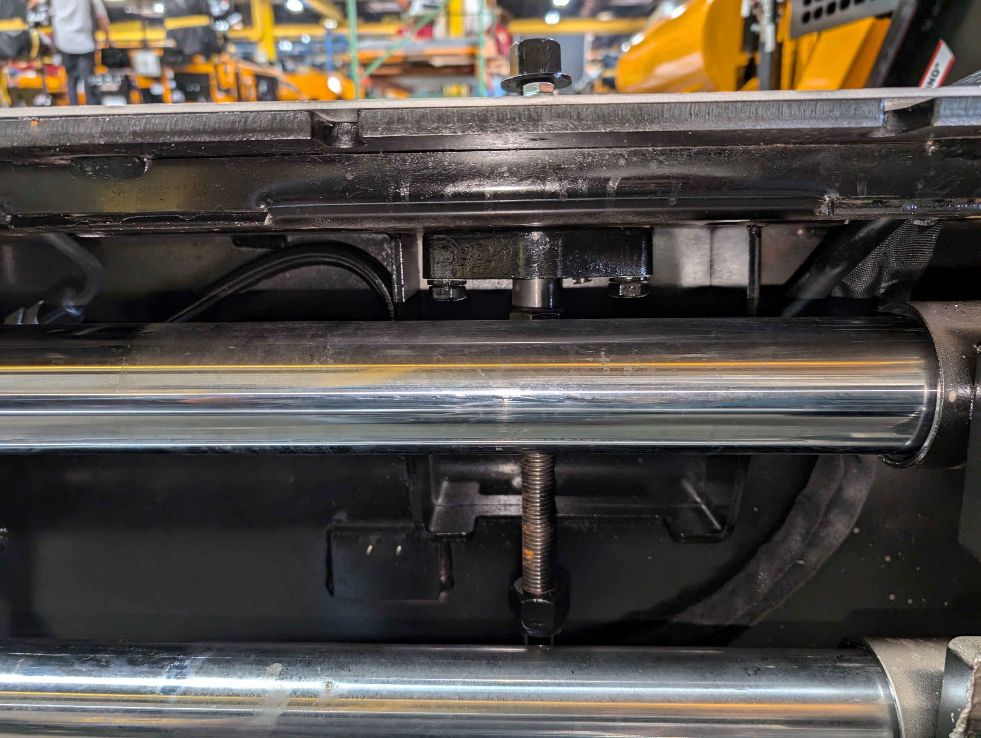
This bearing is also used on
the angle of attack on both extensions.

Slide 5
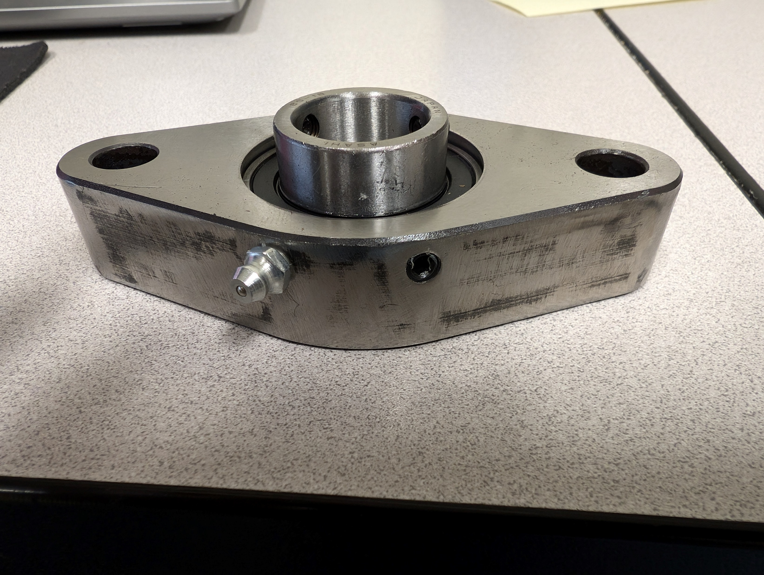
The updated bearing is machined steel and
Can be identified by the set screw next
to the grease fitting. #870030-HD

Slide 6
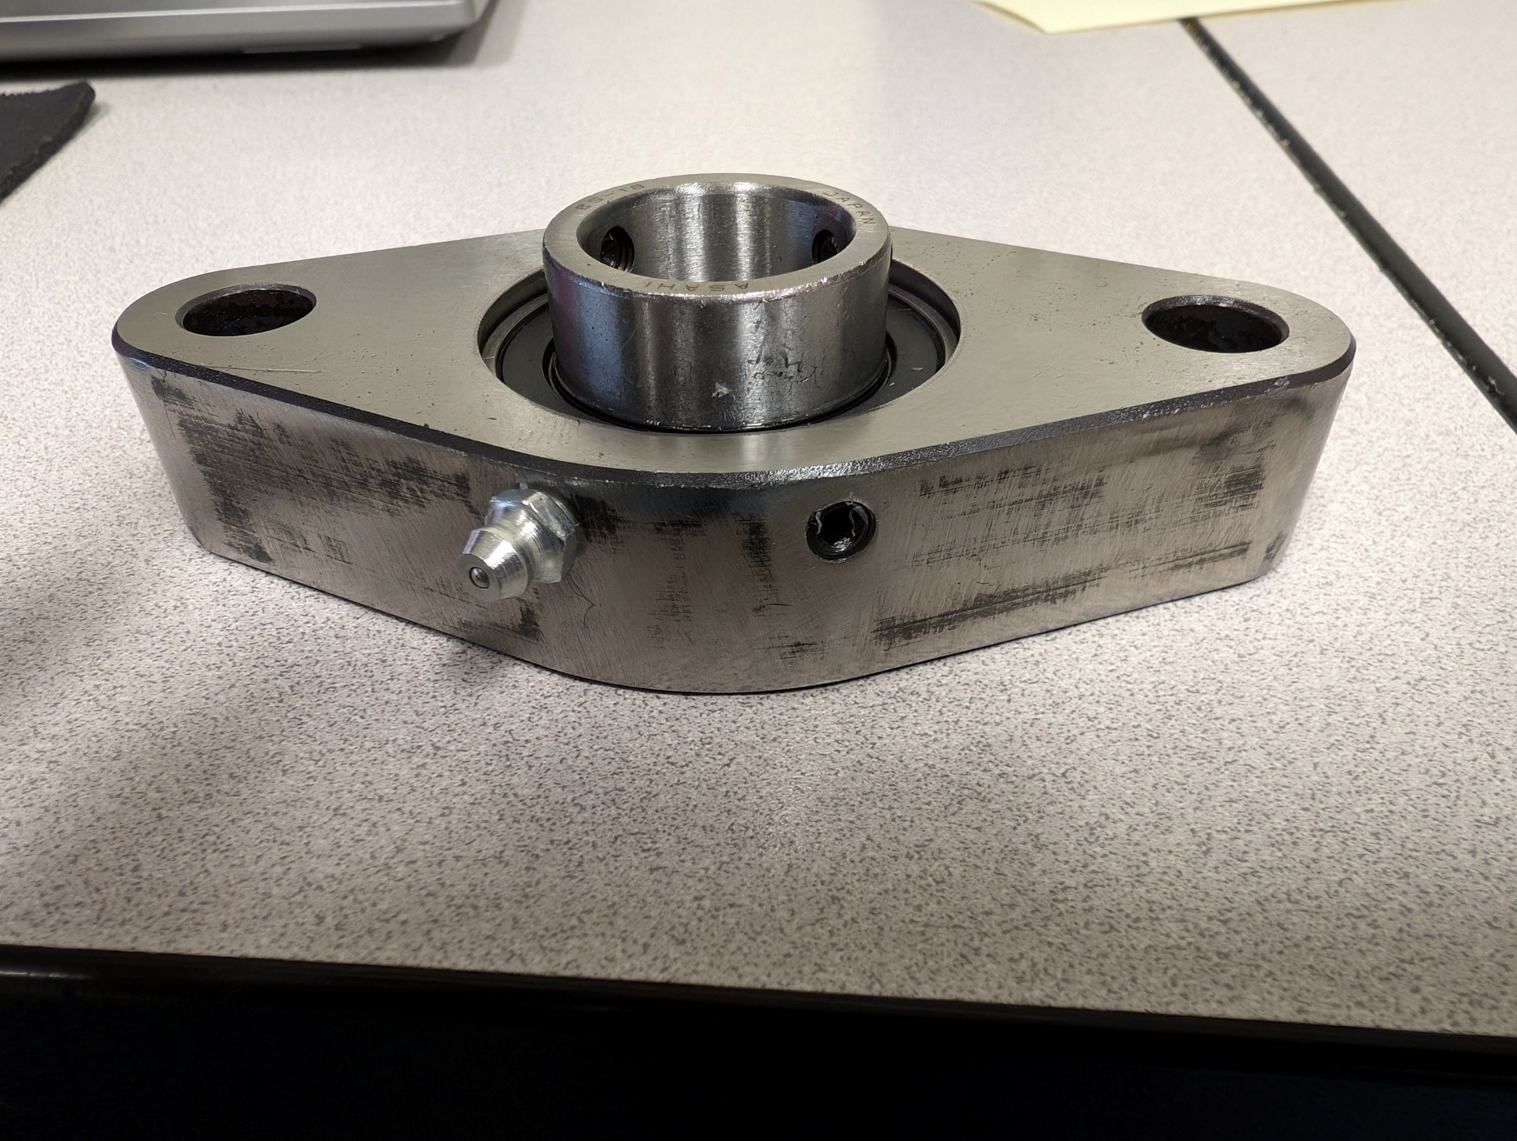
When servicing any of the affected machines.
8520C, 8530, 8608 and 8616D with the pro screed only.
We recommend to inspect these bearings for cracks and replace
If needed.
For questions or concerns please call
Rapid response at 844-205-5499

