Slide 1
Generator Wire Boot Install
August 2024

Slide 2
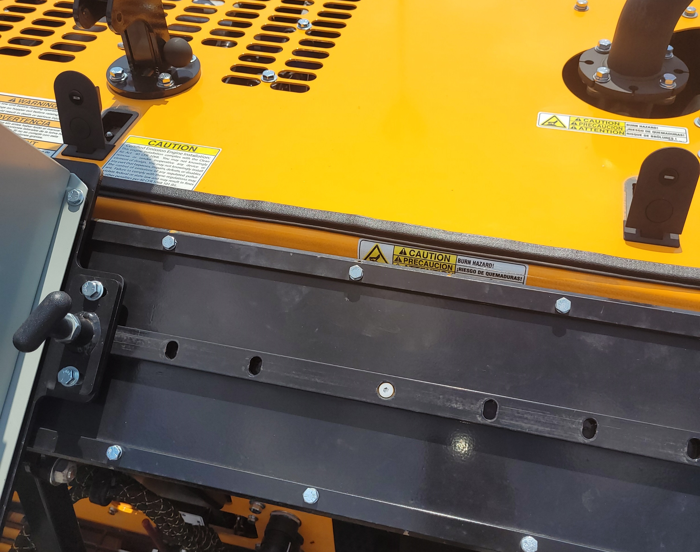
Undo latches on hood

Slide 3
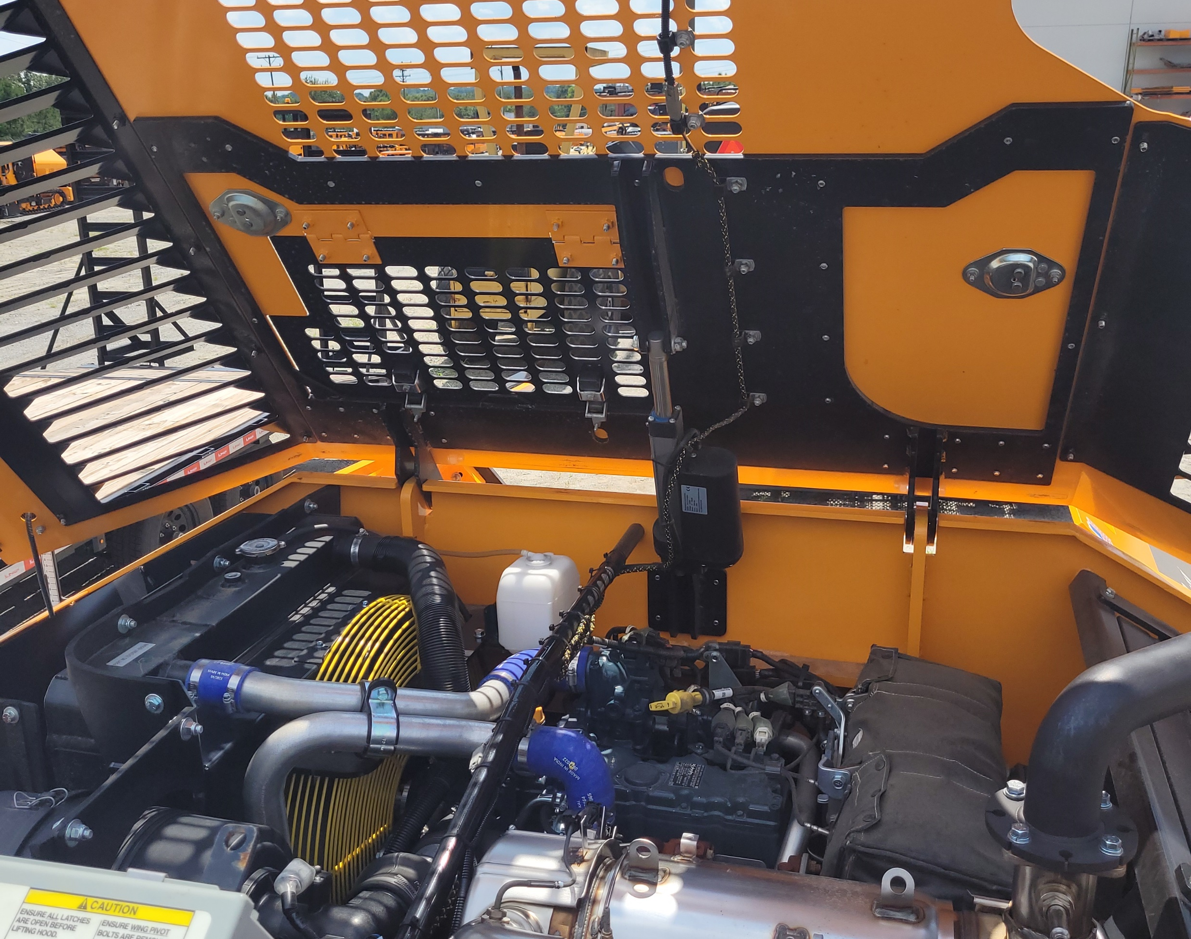
Open hood to get to generator from above.

Slide 4
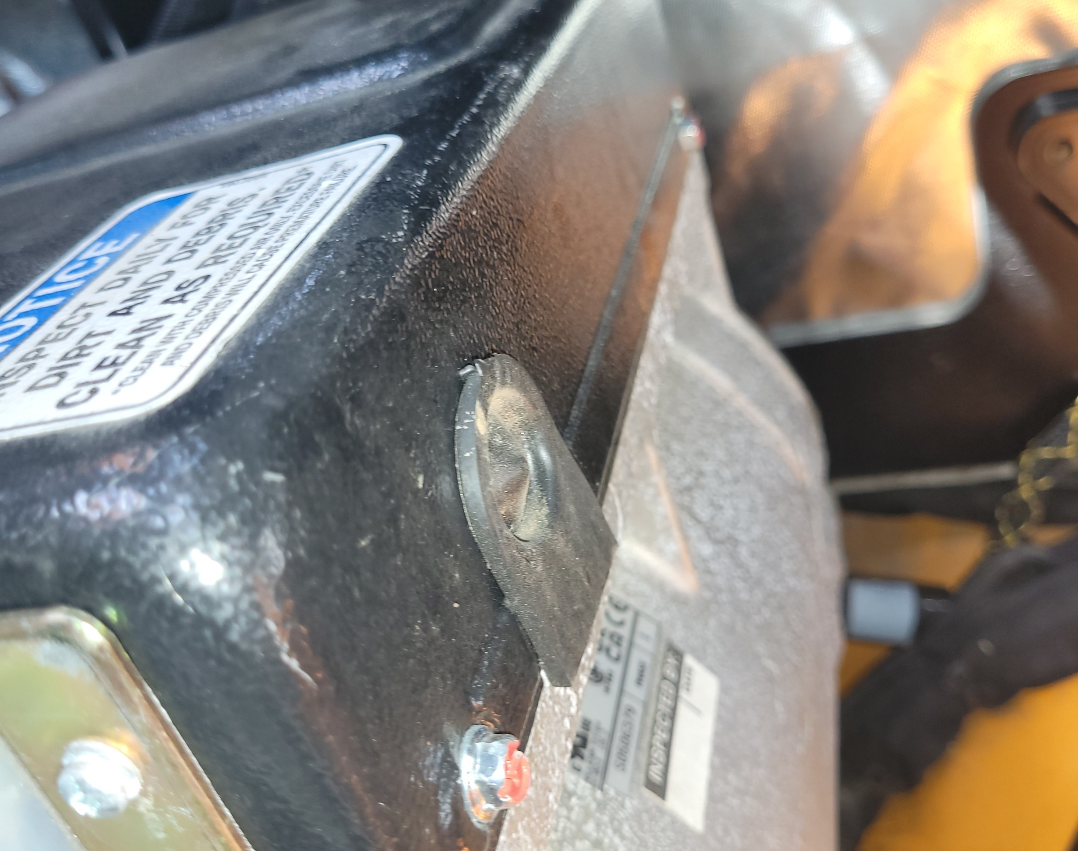
Remove 4 bolts from black cover on generator(2 in front and two in back) with a 5/16 wrench.

Slide 5
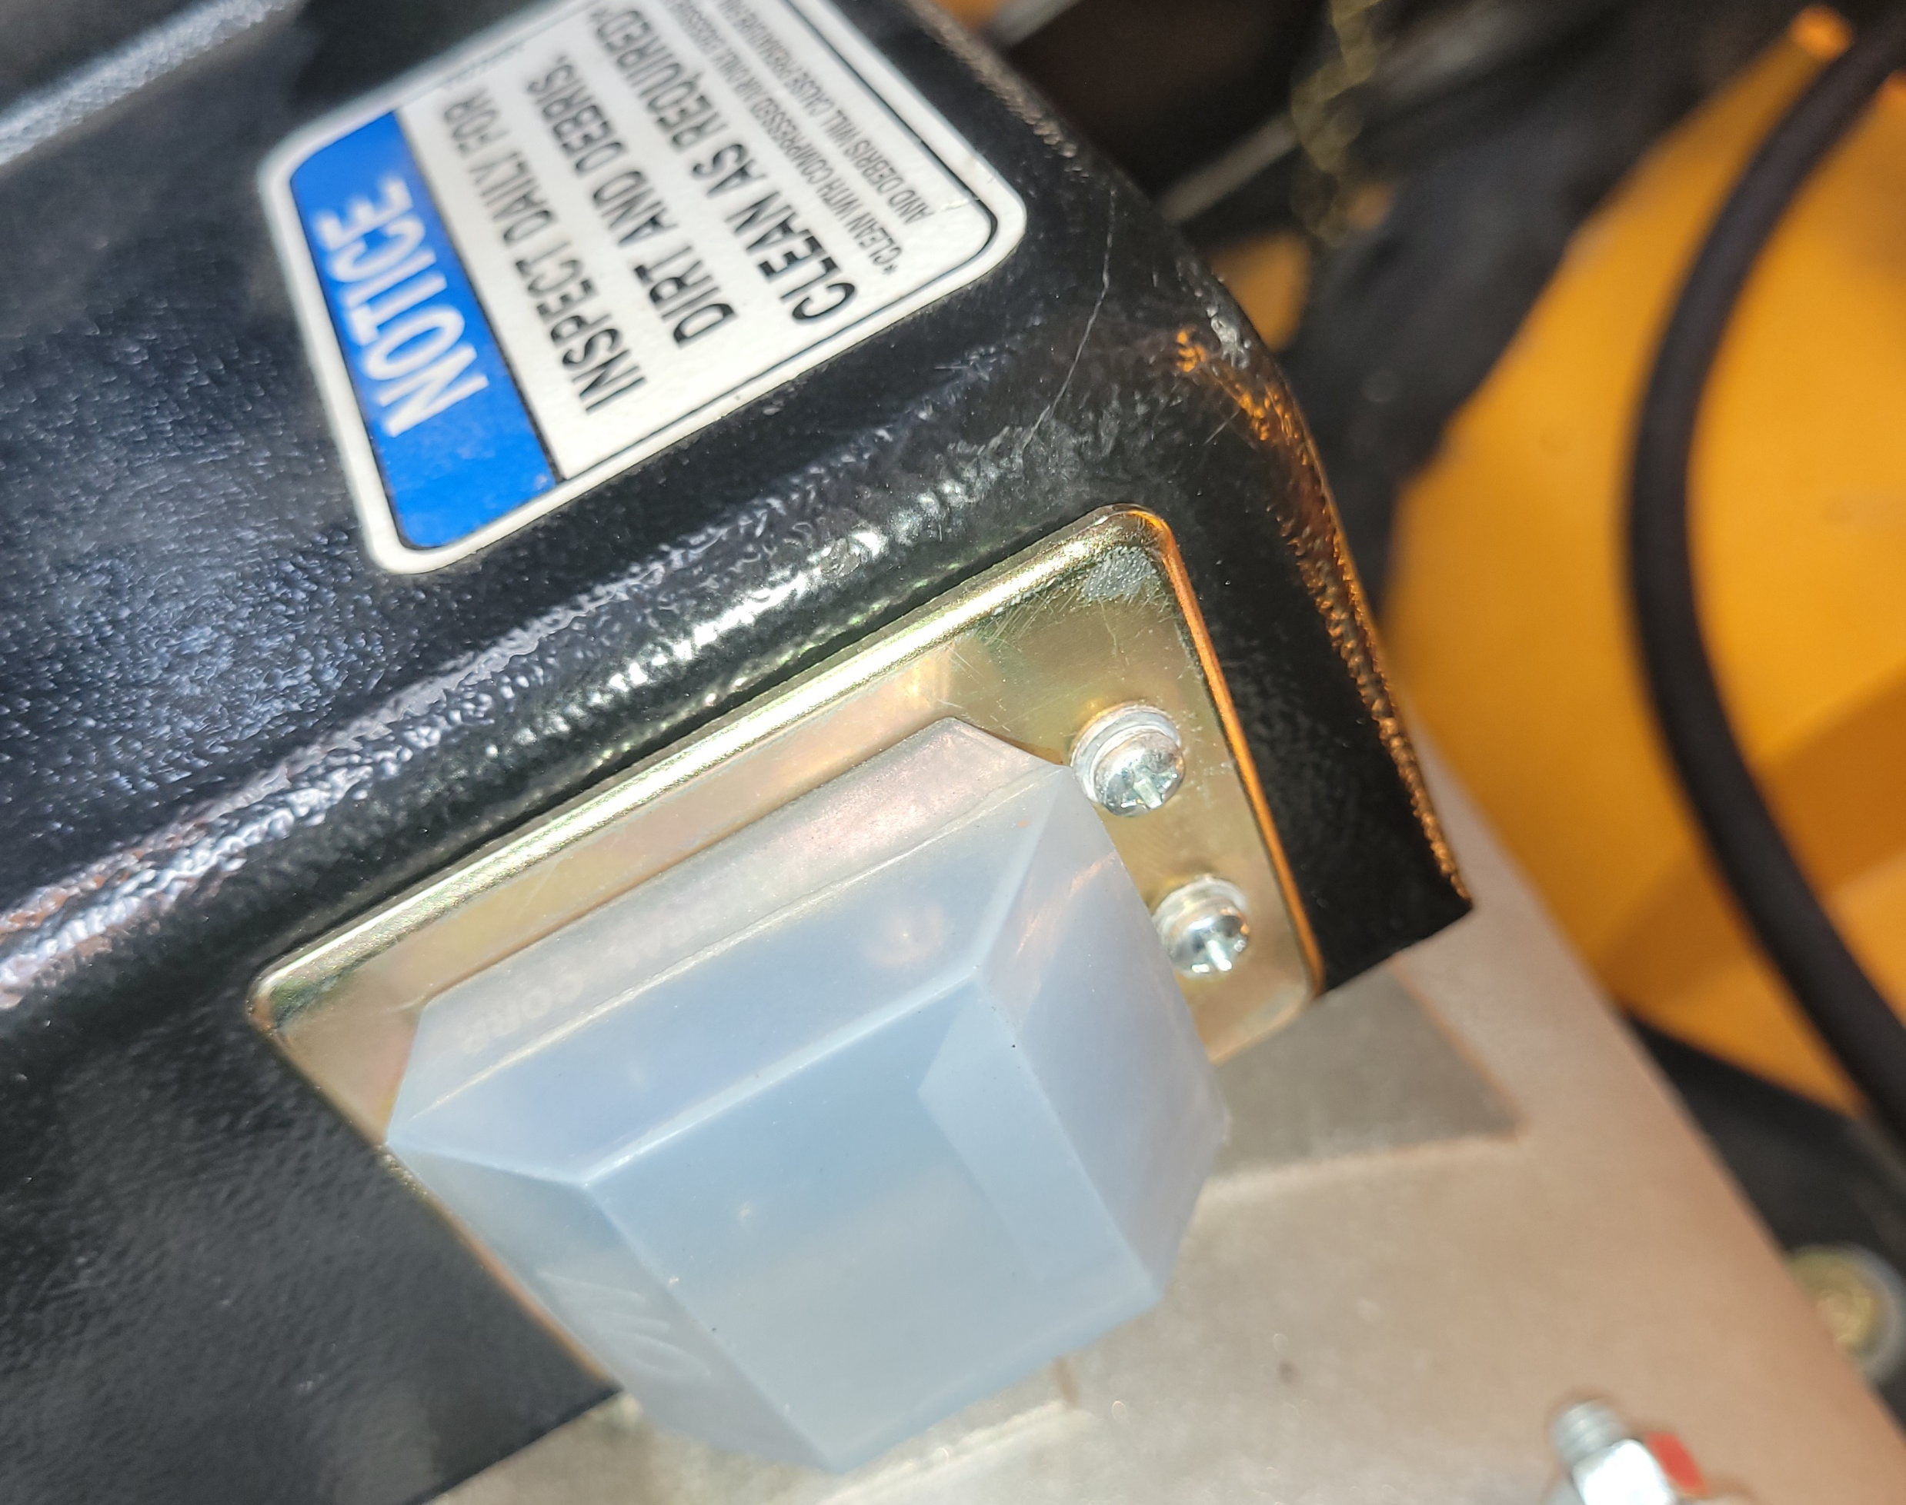
Remove 4 screws holding on breaker cover.

Slide 6
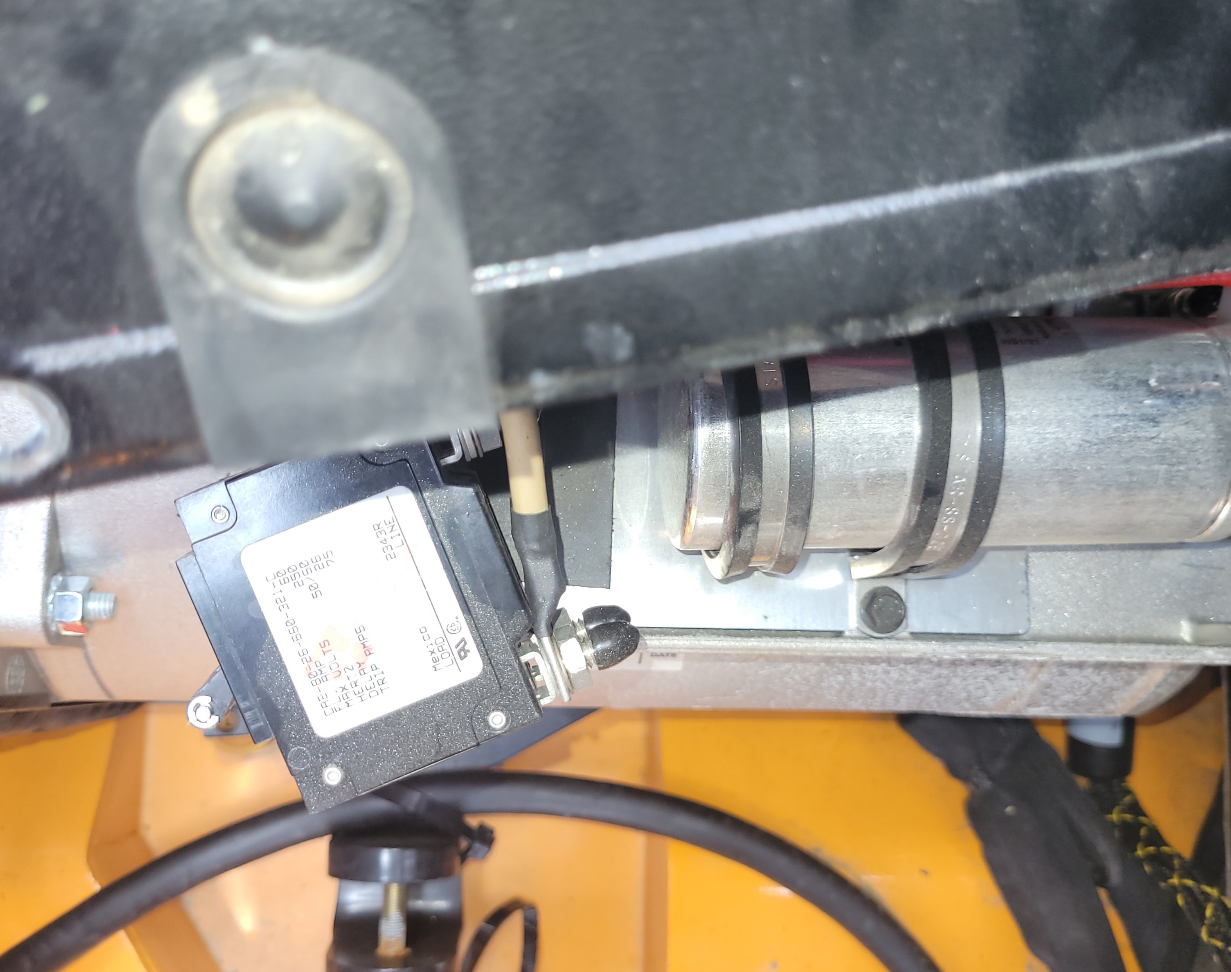
Slide breaker out front under cover to access wiring, and remove wires.(7/16 wrench)

Slide 7
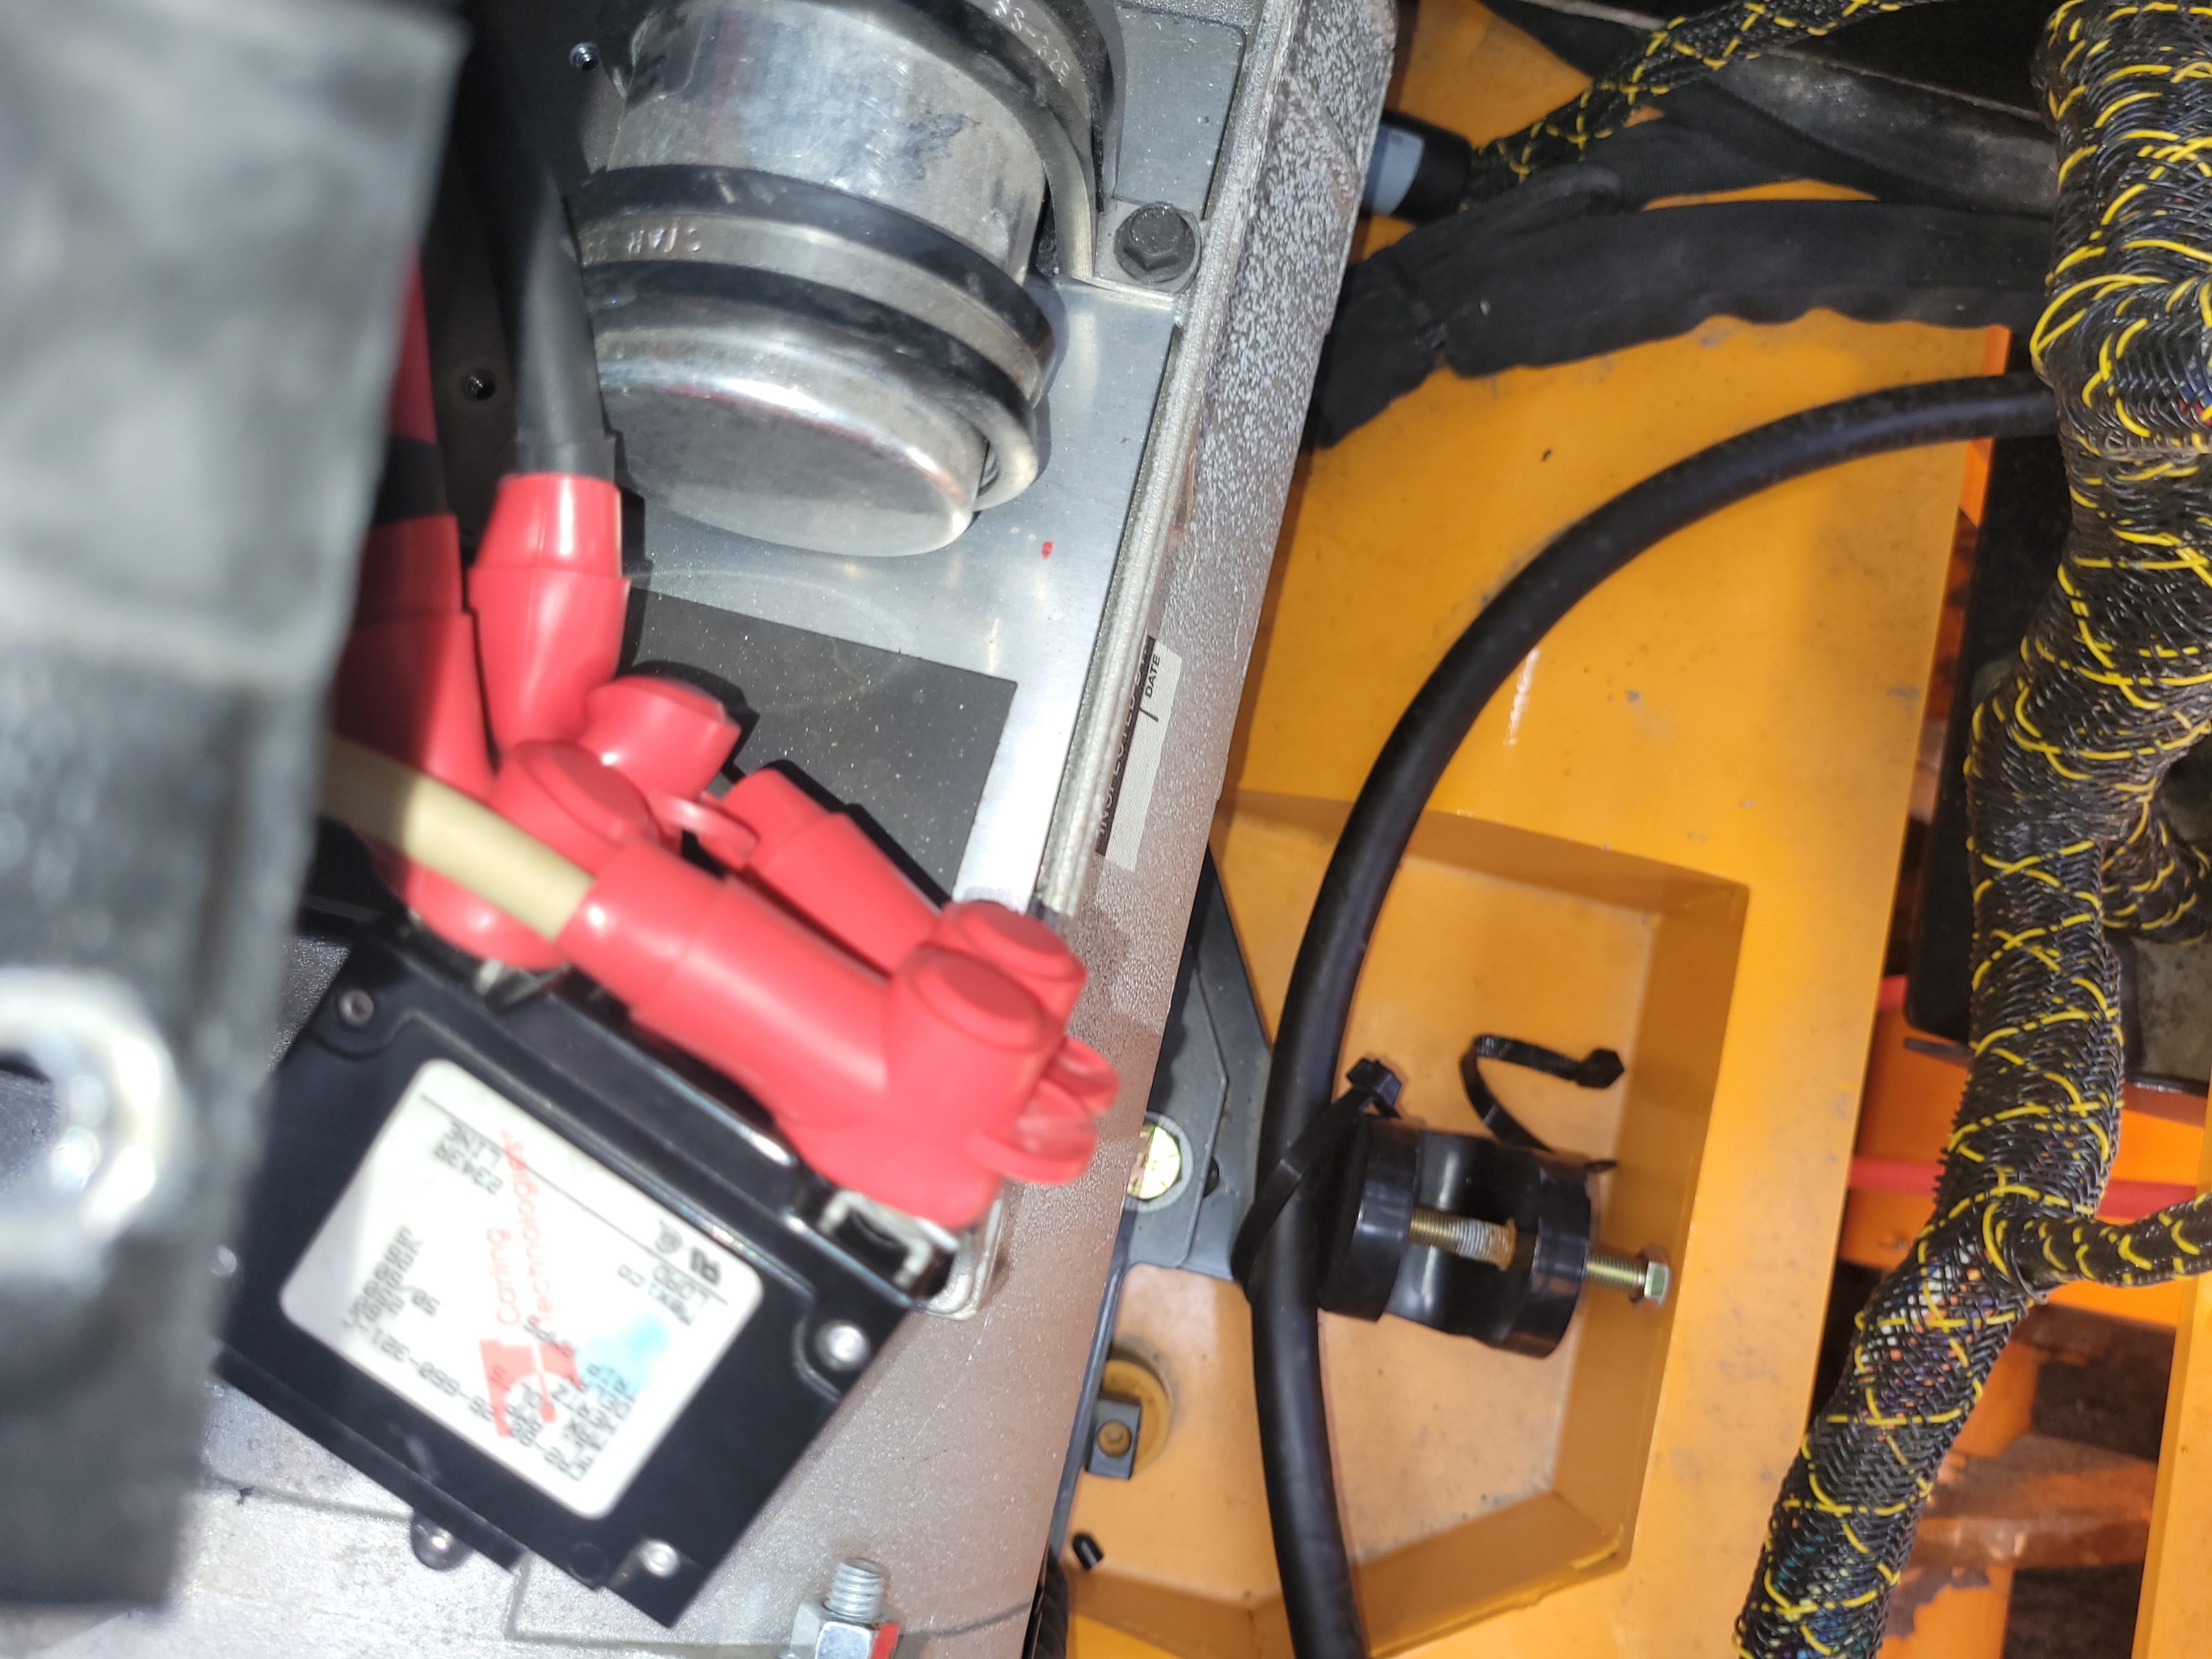
Slide boots on to wires and reinstall wires. Then slide boots up over stud and nut. Reinstall breaker and cover. Then reinstall black cover.

