Slide 1
LeeBoy 685D & 695B Graders Topcon Options
25 May 2023

Slide 2
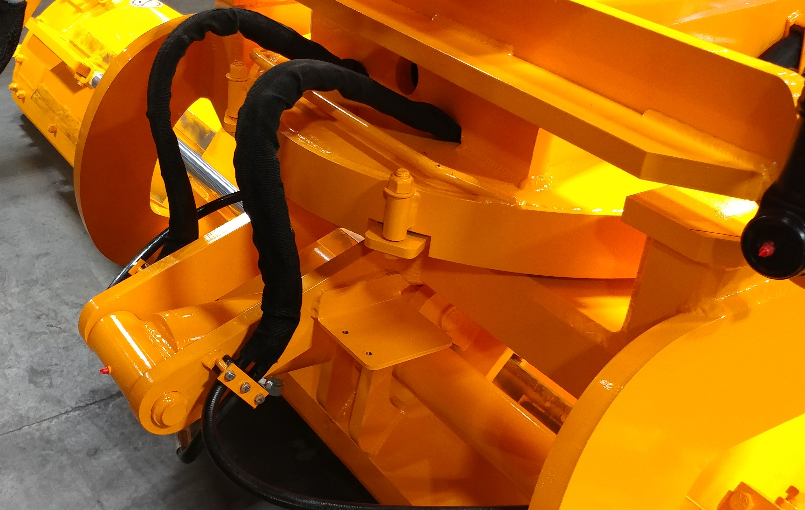
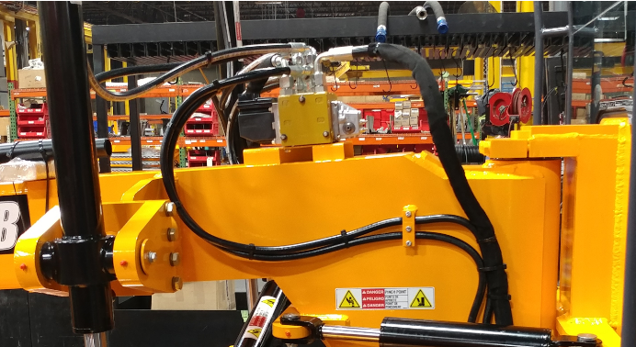
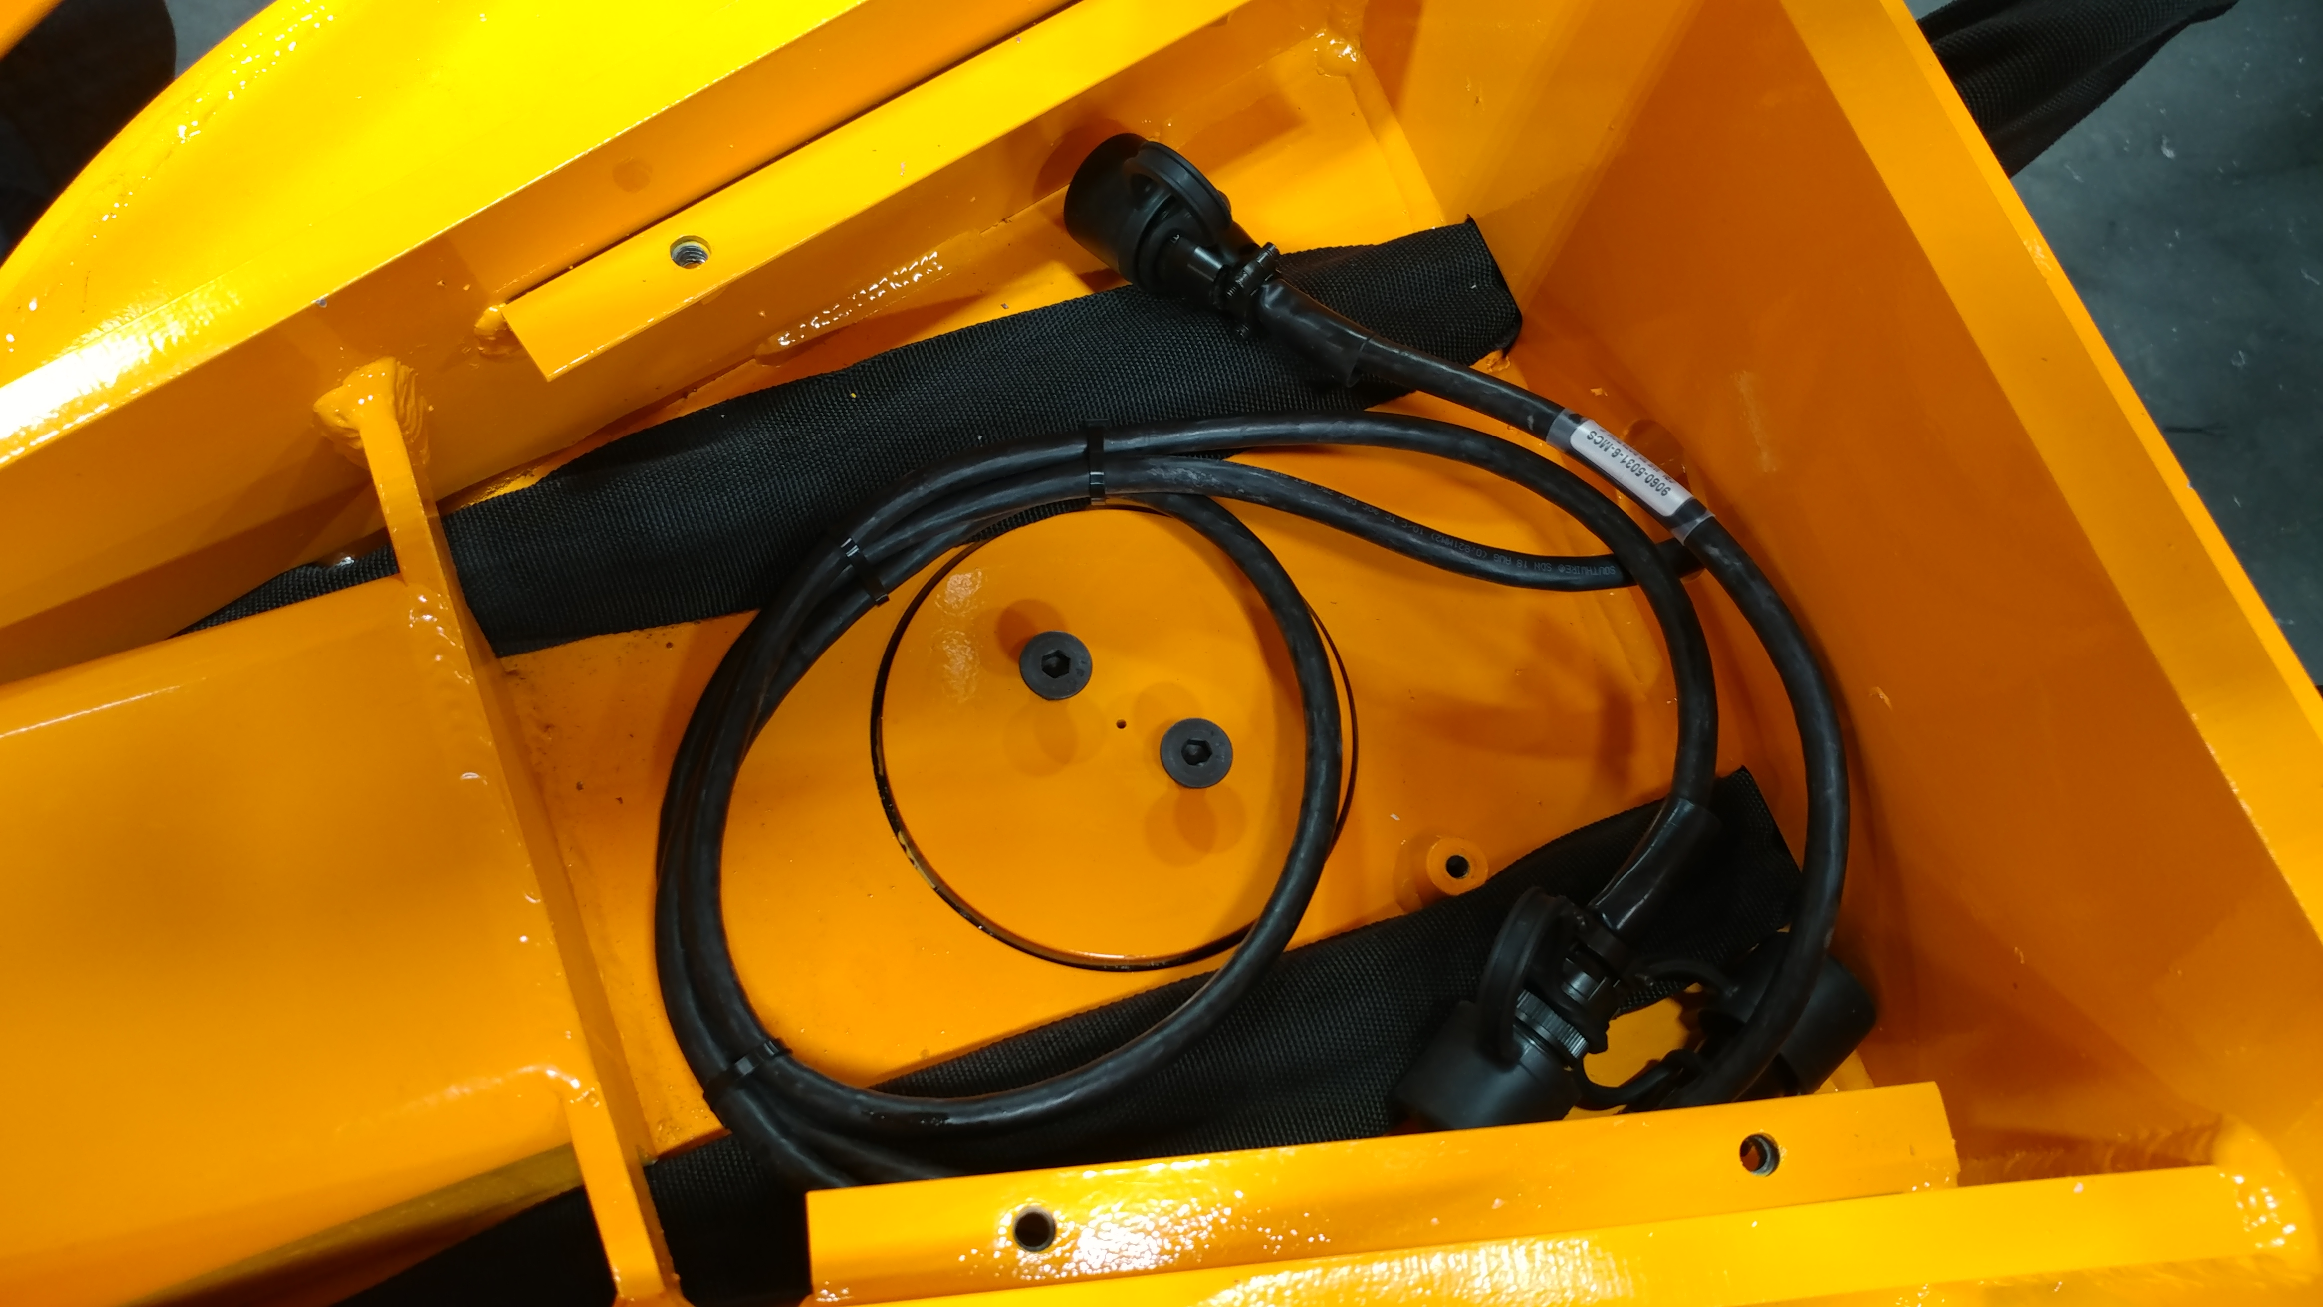
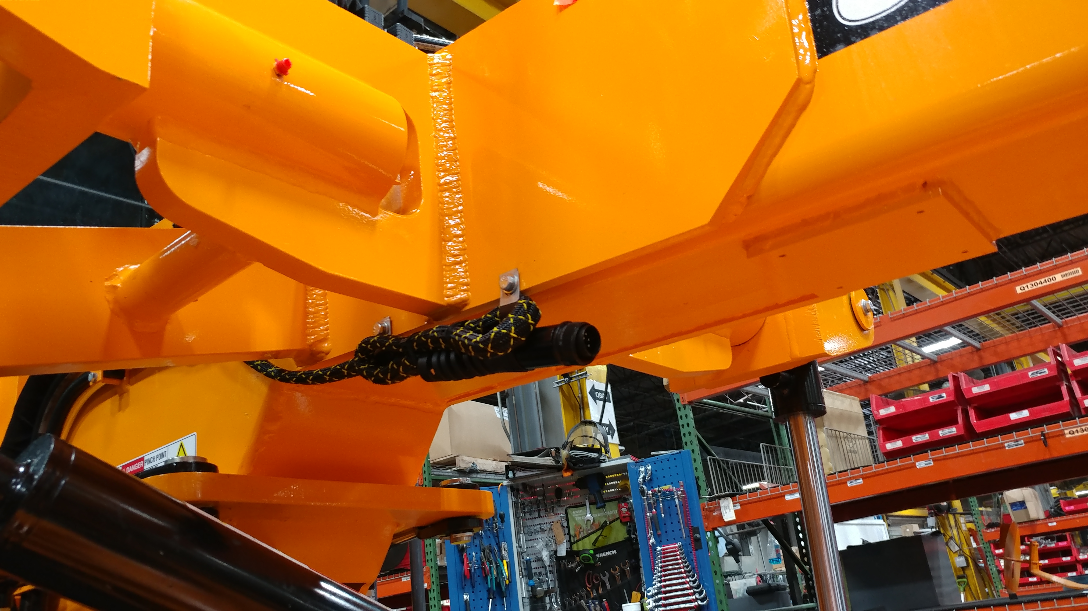
685D & 695B Standard Machine
Includes Mounting Provisions for Topcon components.
Slope sensor mount
Control valve mount
Rotation sensor mount
Mainfall sensor mount

Slide 3
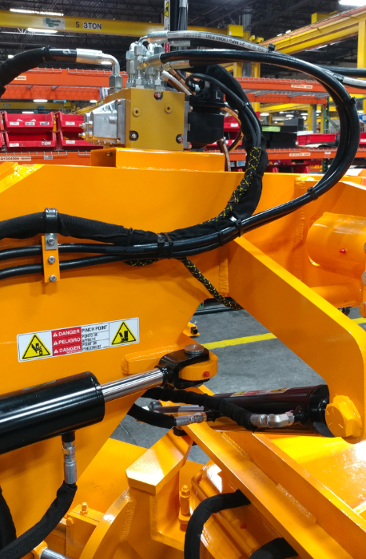
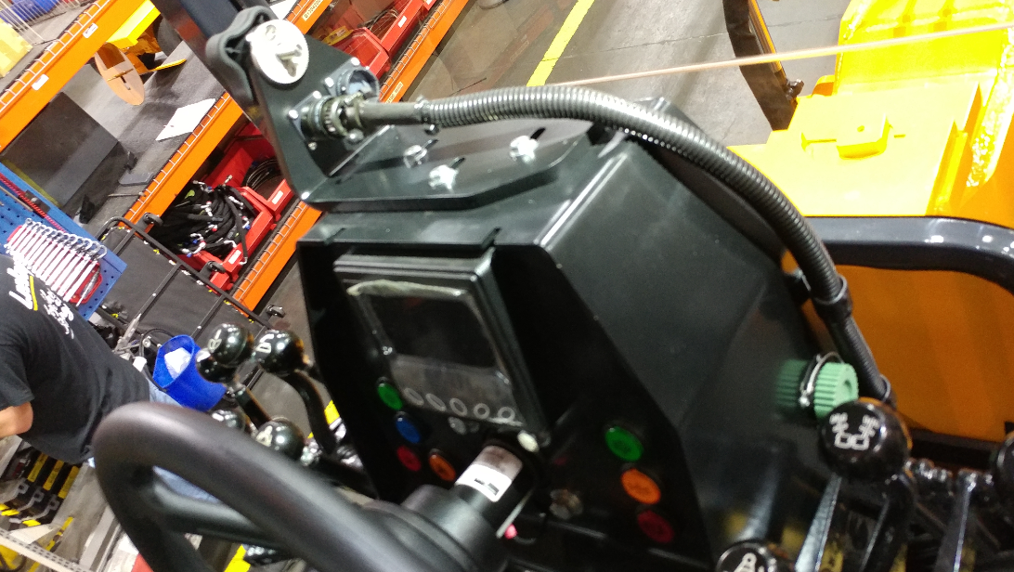
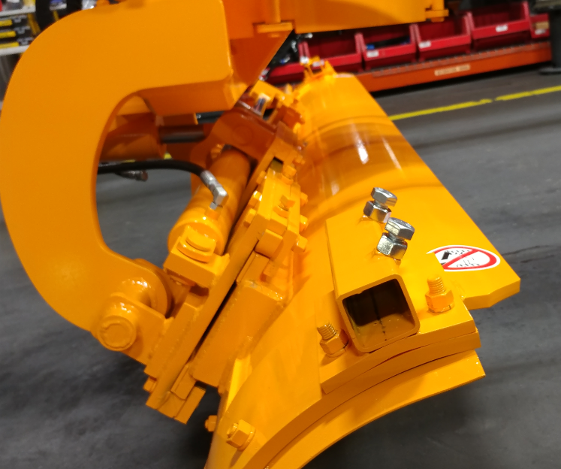
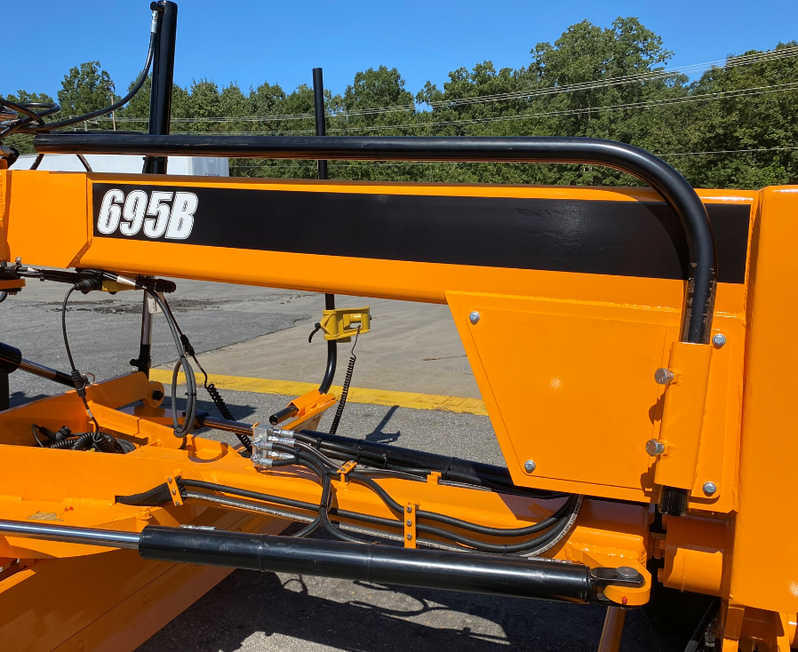
Optional Topcon Ready Package
Includes:
Control valve
Hydraulic plumbing
Sensor cables
Control box mount
Mast mounts on moldboard
Mast storage brackets
Does not include:
Control box & smart knobs
Mainfall sensor
Rotation sensor
Slope sensor
Sonic tracker
Laser tracker
Masts

Slide 4
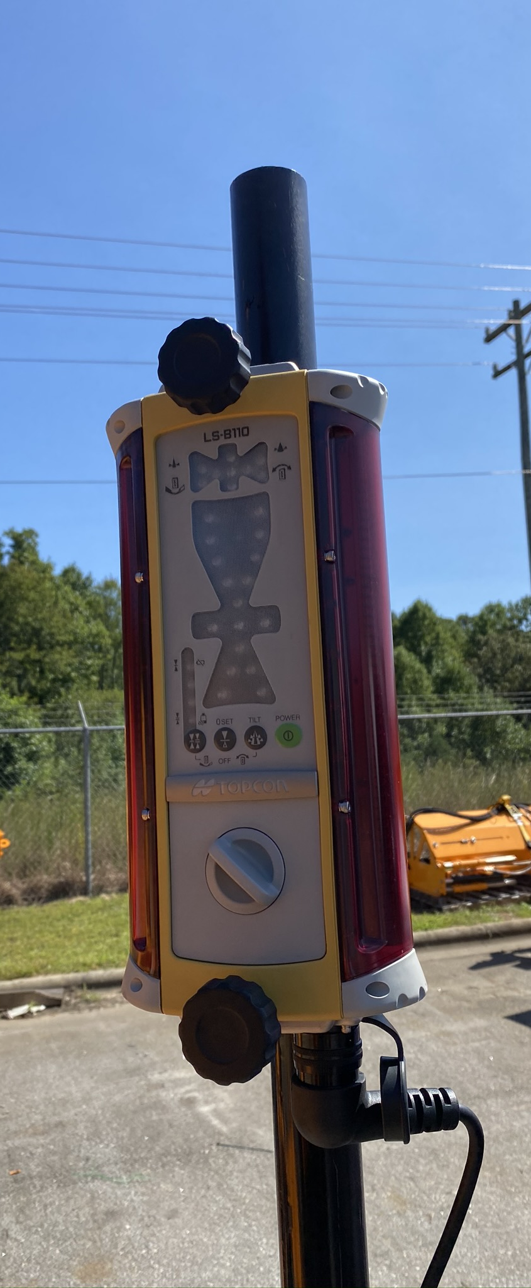
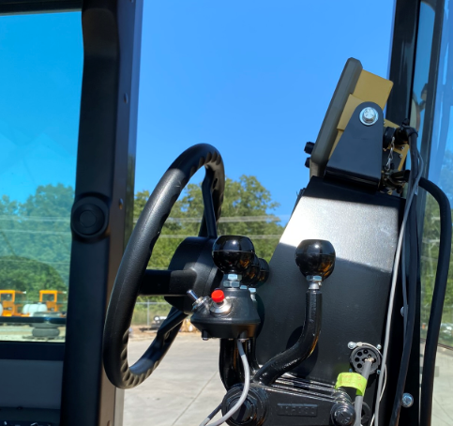
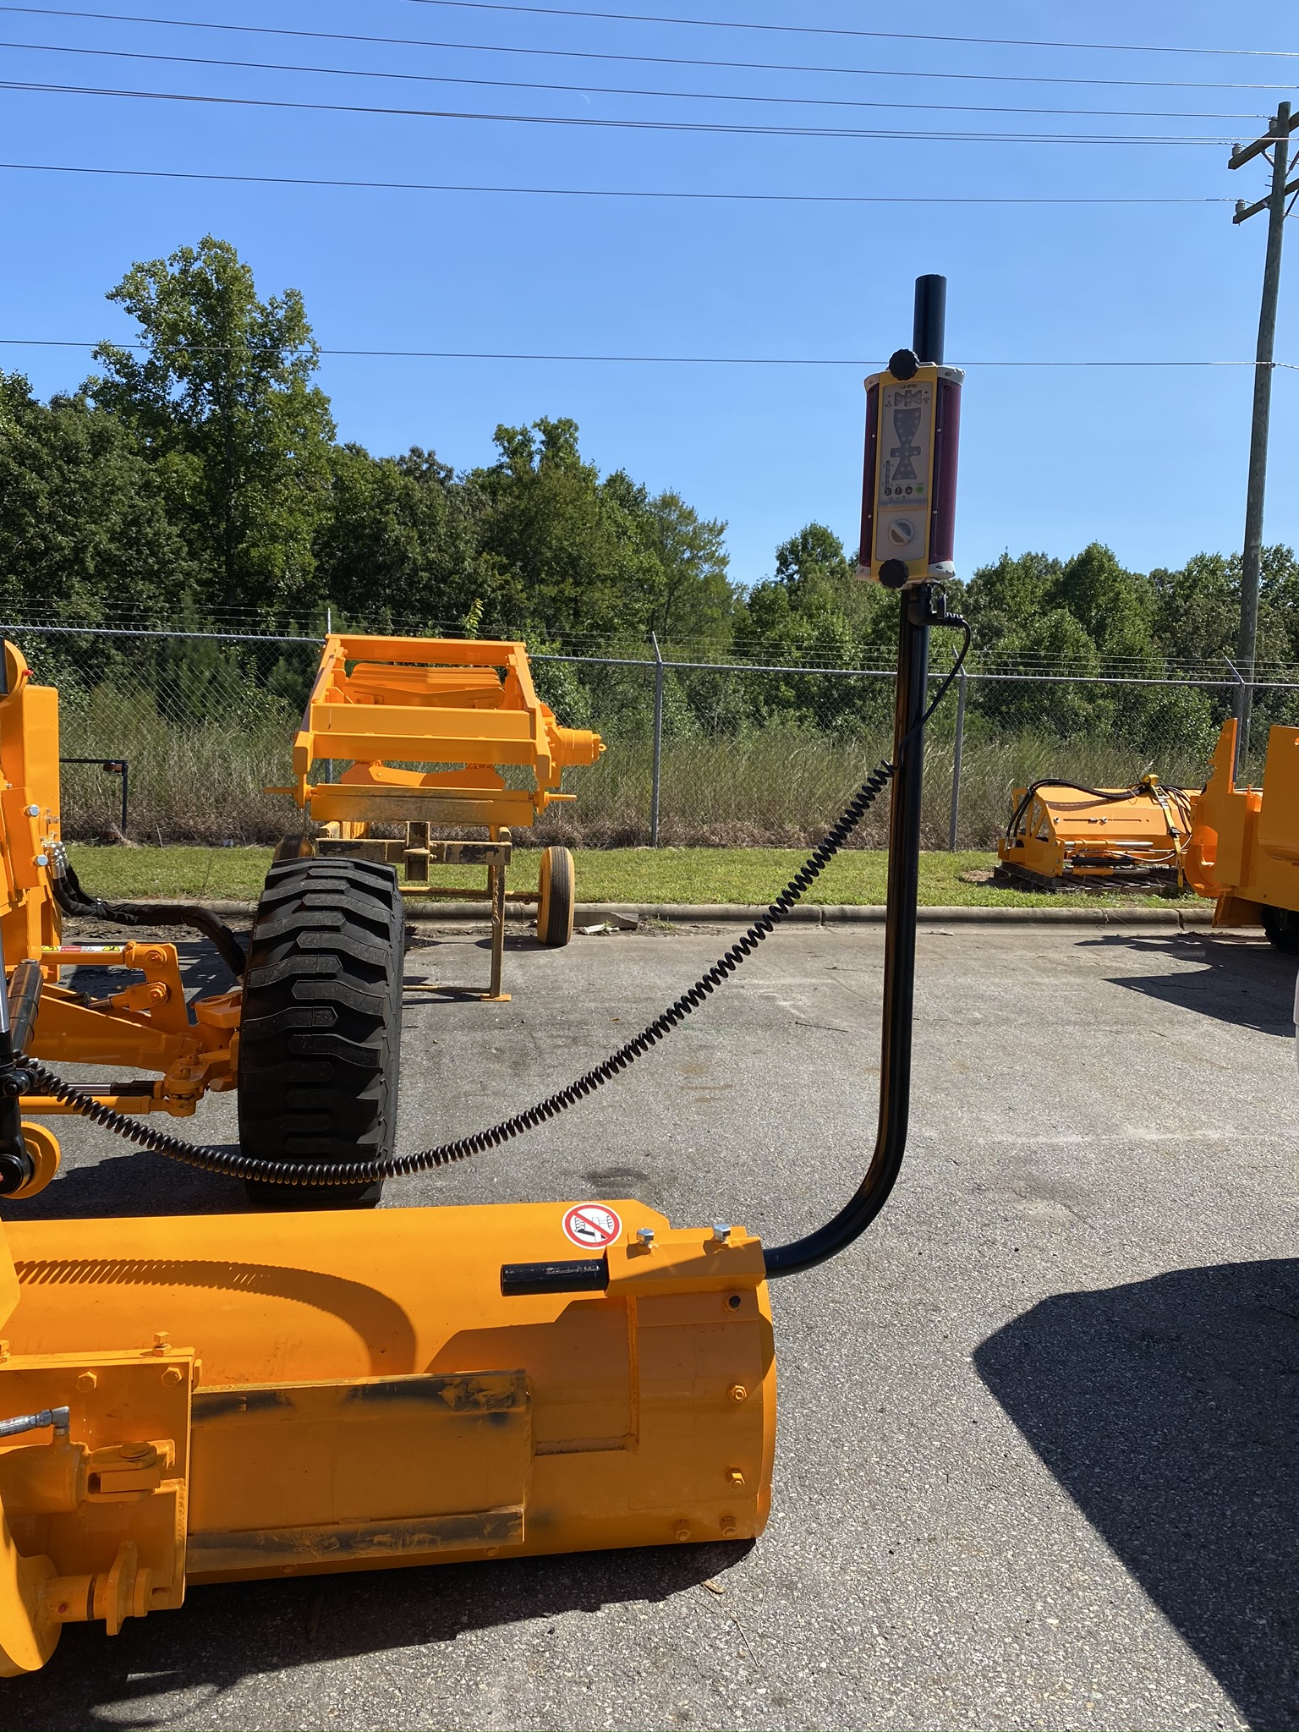
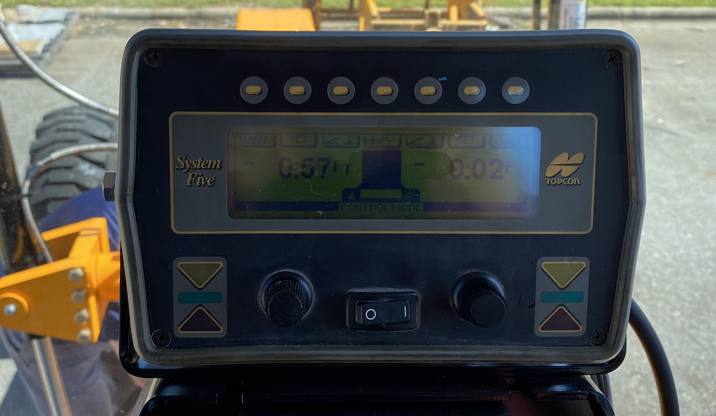
Optional Factory Installed Topcon System Elevation only
Elevation only base system includes:
Control box & smart knobs
Junction box
Carrying case
Add desired sensor option(s):
Sonic sensor -with mast, bracket, & cable
Laser receiver -with mast, cable & case

Slide 5
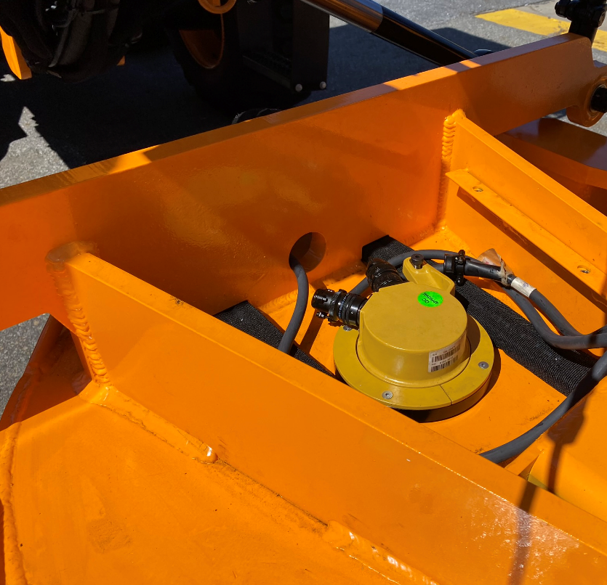
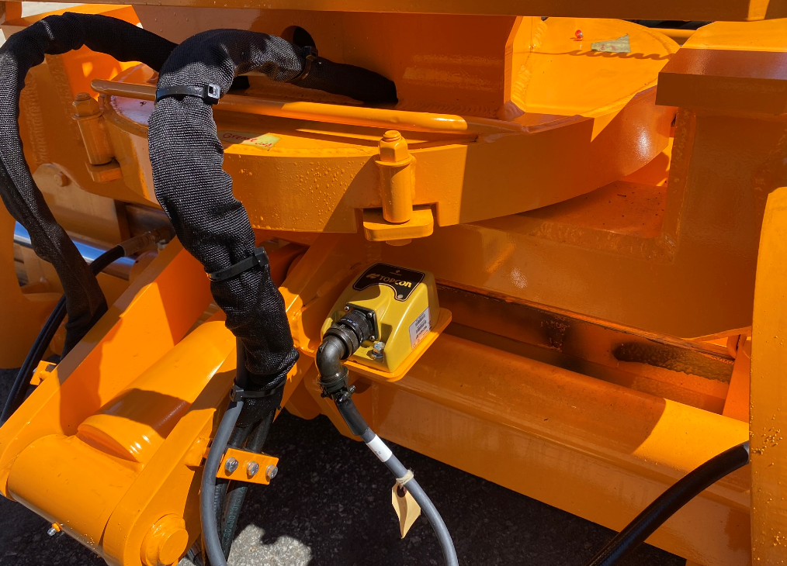
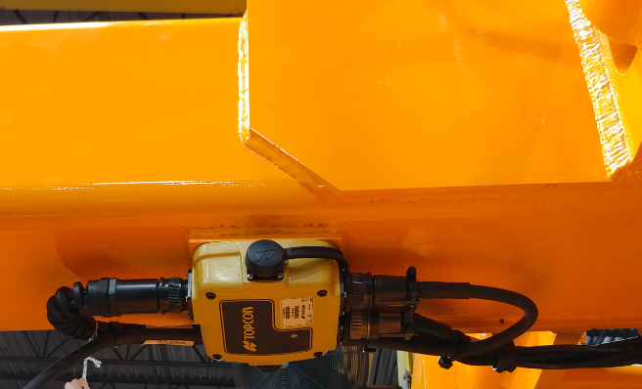
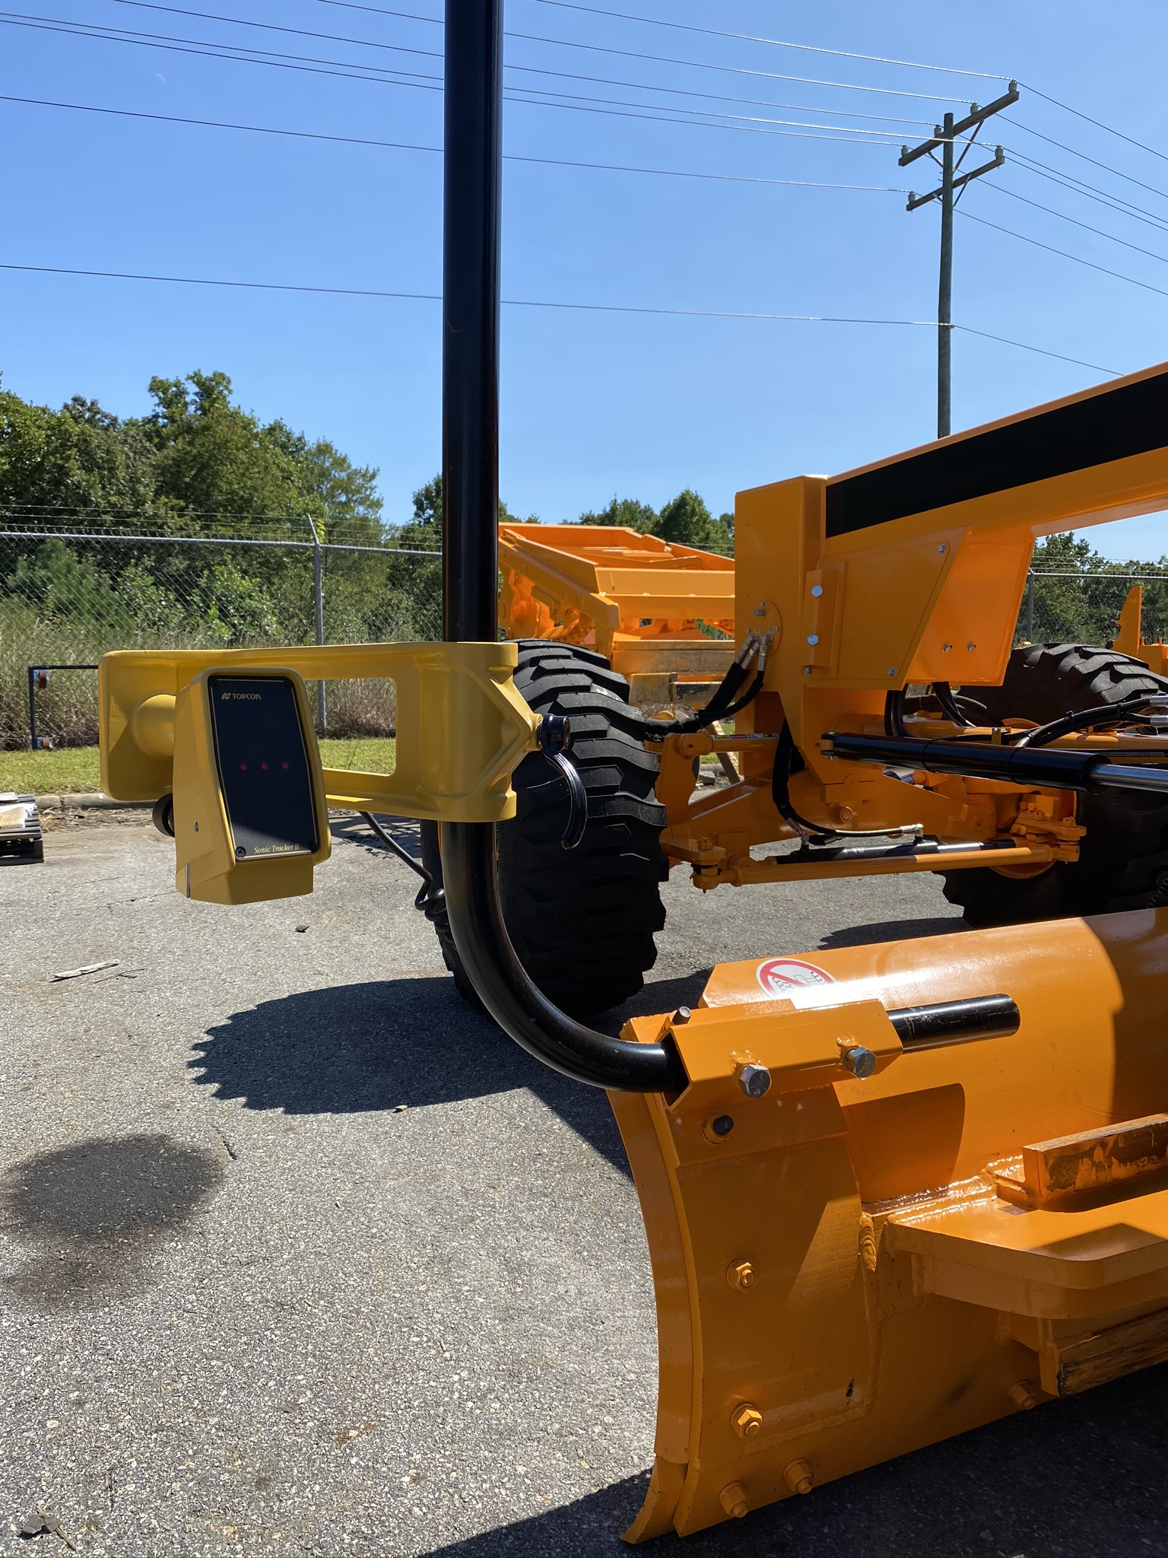
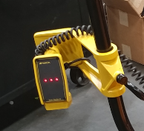
Optional Factory Installed Topcon System Elevation and slope
Elevation & slope base system includes:
Control box & smart knobs
Mainfall sensor
Rotation sensor
Slope sensor
Carrying case
Add desired sensor option(s):
Sonic sensor -with mast, bracket, & cable
Laser receiver -with mast, cable & case

Slide 6
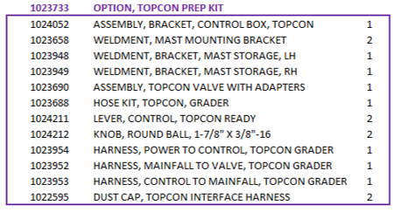
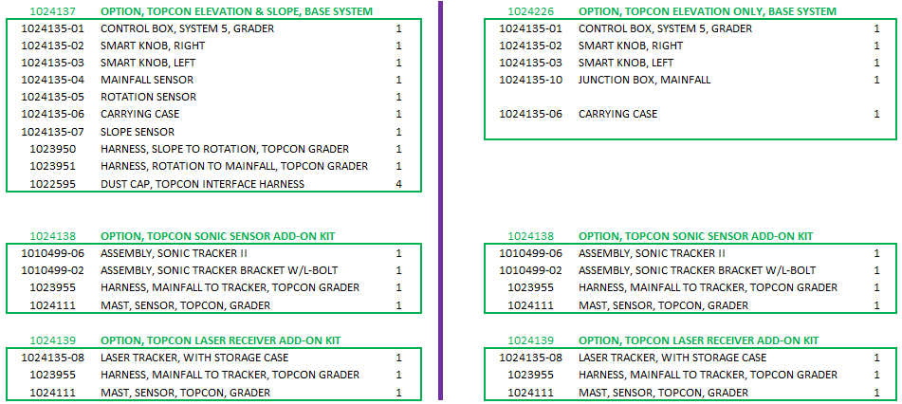
Topcon Options Configuration

Slide 7
Thank You

