Slide 1
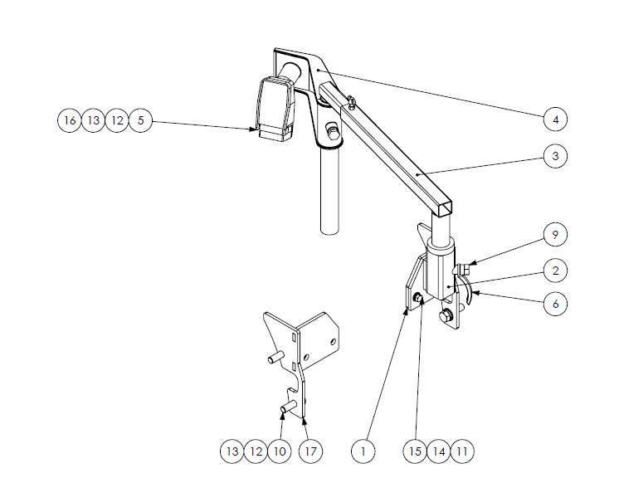
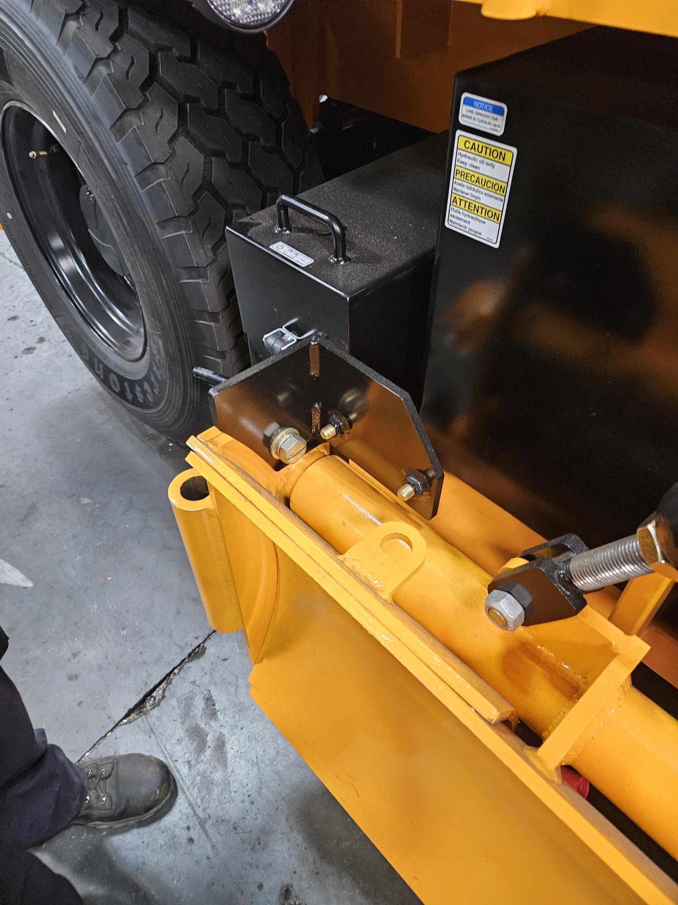
4130B – Z-arm assembly and sensor
#5 PN: 1010499-06 - ASSEMBLY, SONIC TRACKER II
#4 PN: 851578 - BRACKET, SONIC TRACKER, TOPCON
#3 PN: 9090-1125 - BRACKET Z ARM TOPCON
#2 PN: 851575 - PIVOT MOUNT, TOPCON / SPECTRA
#1 PN: 1021158 - WELDMENT, RIGHT TOPCON GRADE MOUNT, RW85
#17 PN: 1021157 - WELDMENT, LEFT TOPCON GRADE MOUNT, RW85

Slide 2
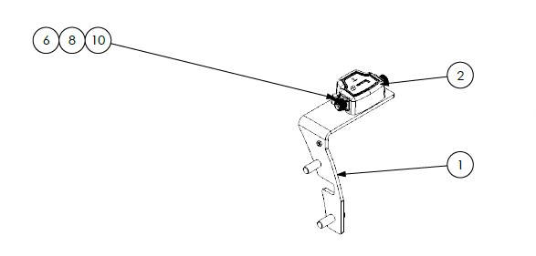
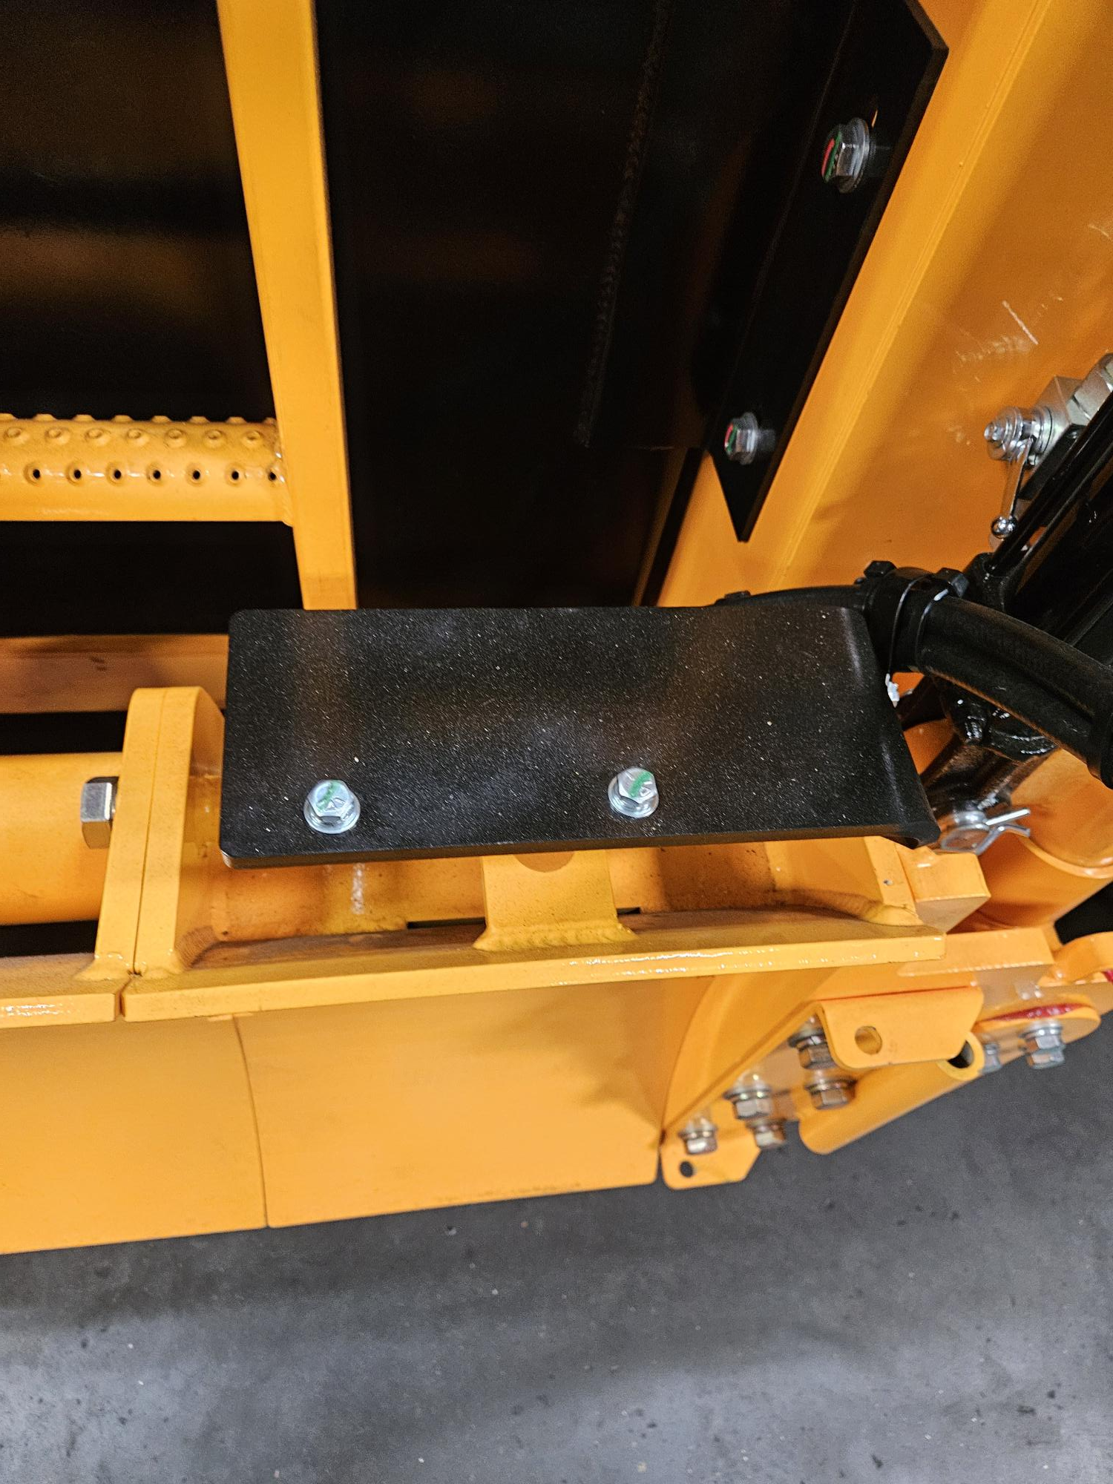
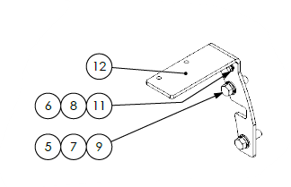
4130B - Slope mount
#2 PN: 1010499-09 - MODULE,SLOPE,P-32
#1 PN: 1021155 - WELDMENT, RIGHT TOPCON SLOPE MOUNT, RW85
PN: 1021155 or 1021156 – mounts on the moldboard
#12 PN: 1021156 - WELDMENT, LEFT TOPCON SLOPE MOUNT, RW85

Slide 3
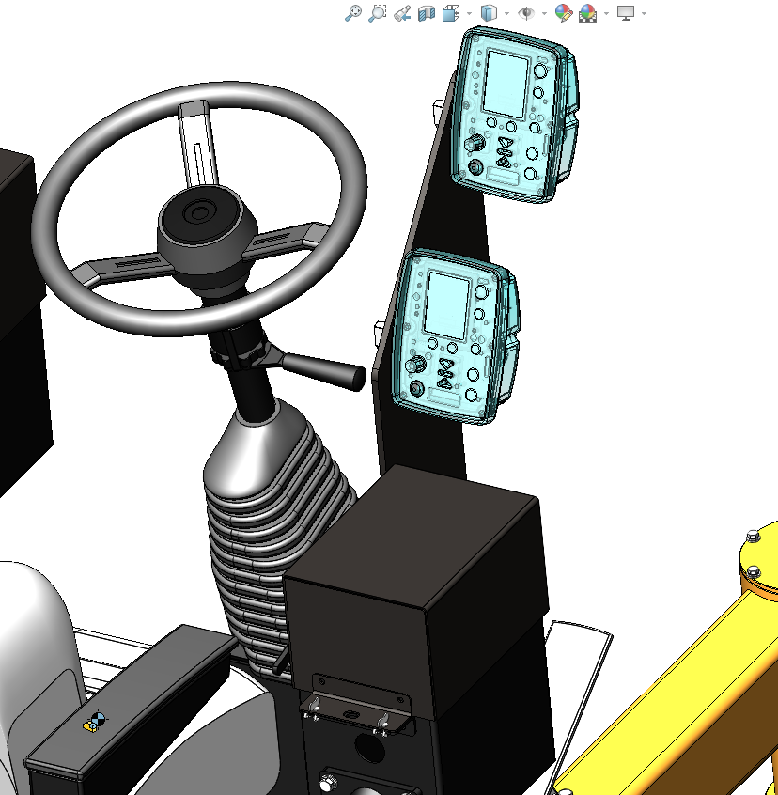
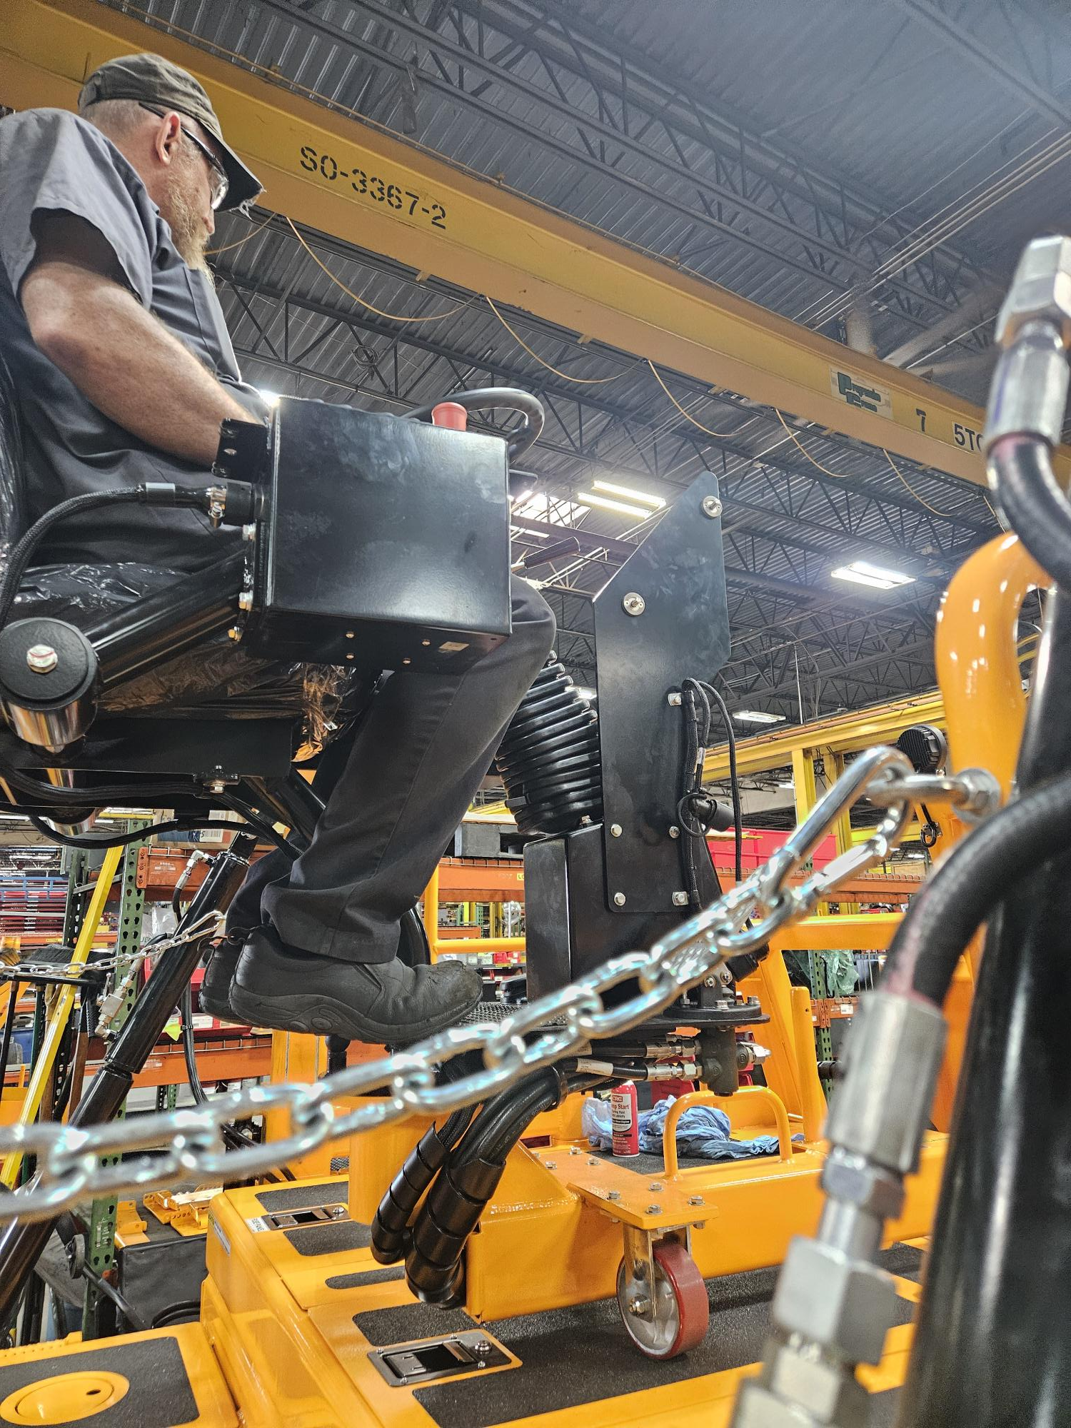
4130B – GC-35 CONTROLLER
PN: 1010499-08 - ASSEMBLY, GC-35 CONTROLLER
NOT SHOWN - Connect controller and sensors w/PN: 1010499-04 - ASSEMBLY, 15 FT GC-35 / TRACKER COIL CORD

